Slide 1

EProject 2
Number :
Ho Ngoc Duc (leader)
Le Hoang Phuc Bao
Vu Thi Thom
Dang Minh Thoi
Instructor :
Mr. Phan Huu Tri

Slide 2
project content
I
1. Topic :
Employee transfer management
2. Introduction :
Wants to develop an application for maintaining
information related to its employees transfer and generating the transfer
related documents.
This application would be facilitating the system
administrator (Higher Management) to search the employees transfer record,
make new transfers and also amend the allowances offered to the employee, which usually depends on the post of the employee and the type of transfer
he is getting.

Slide 3
Implementation technology
II
Eclipse IDE for enterprise java ( Swing )
Xampp

Slide 4
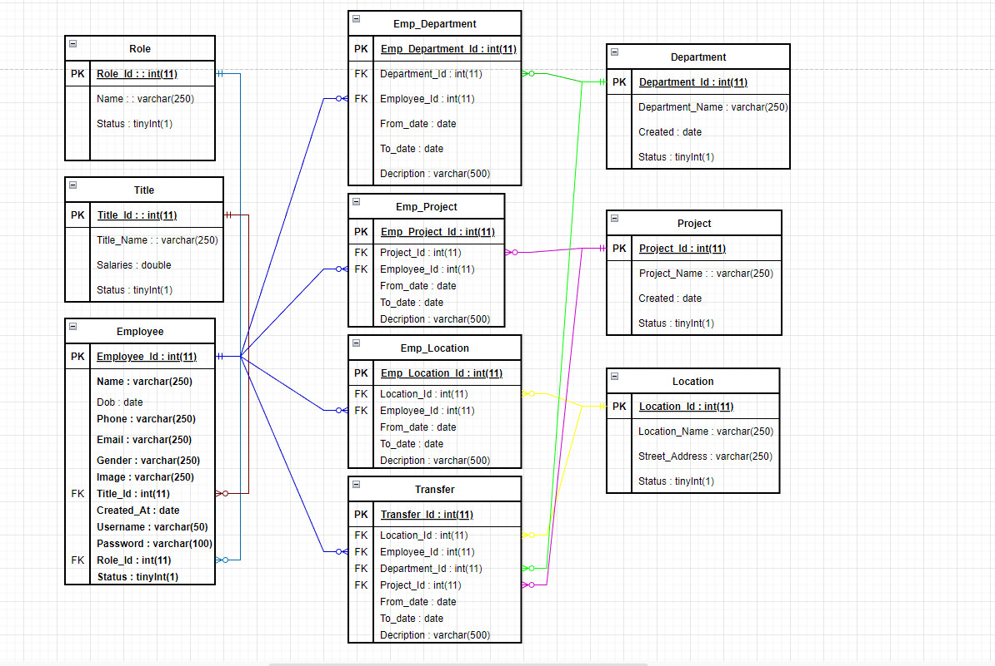
IV - Database

Slide 5
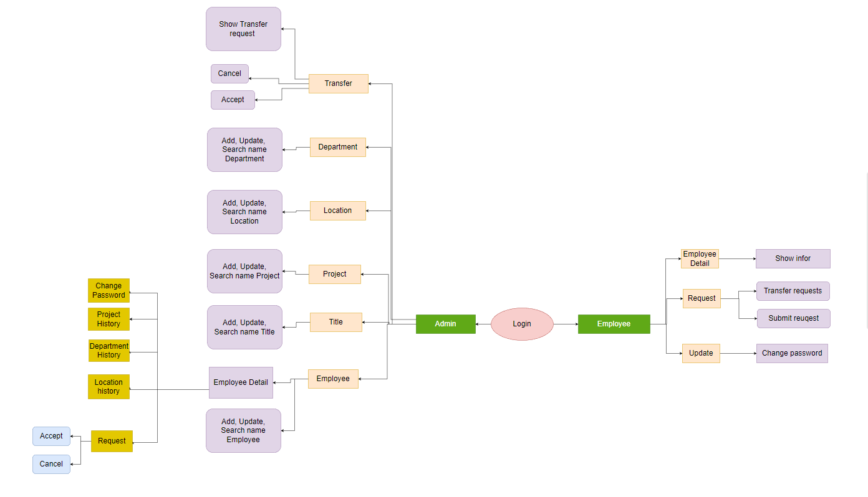
IV - Diagram

Slide 6
THANK YOU!

